Slide 1
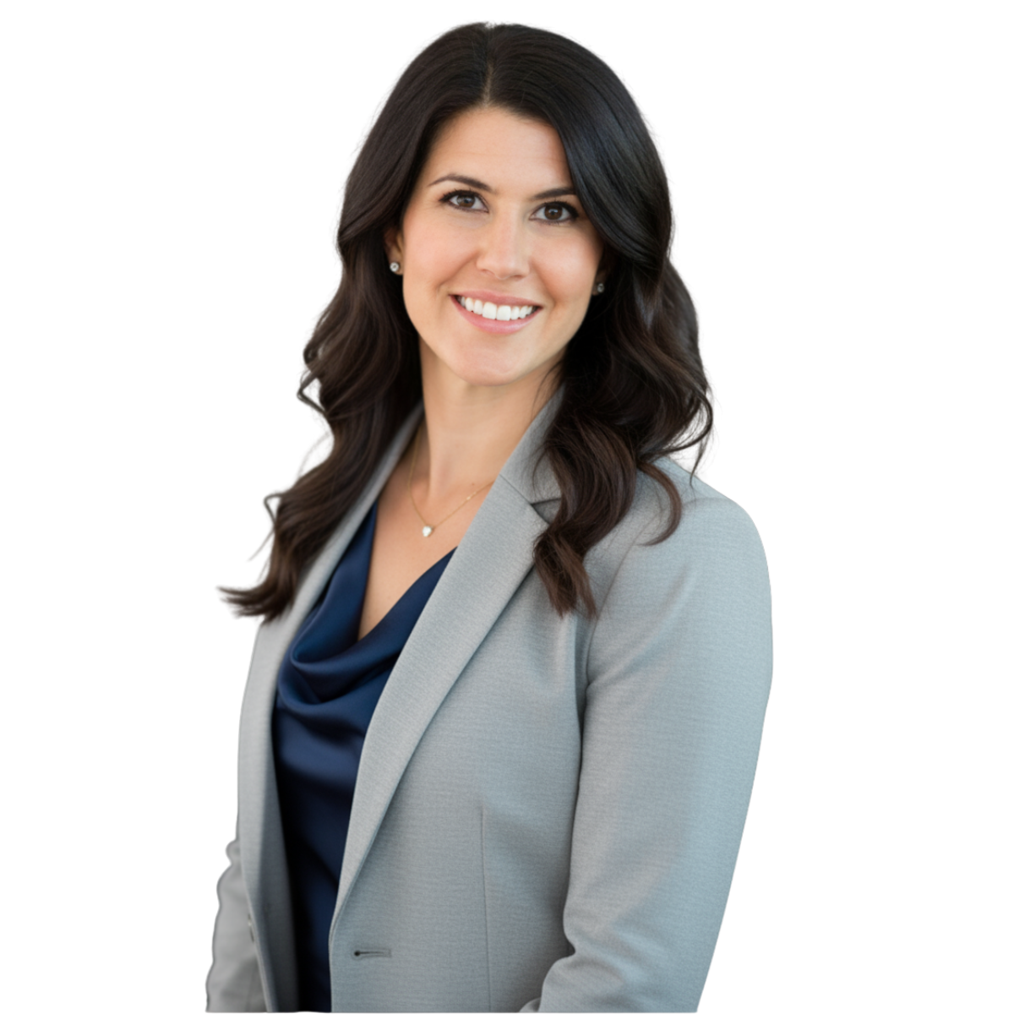
logan@goodknightconsulting.net
goodknightconsulting.net
linkedin.com/in/loganmcknight
LOGAN McKNIGHT
SPEAKER | TRUSTED EXECUTIVE ADVISOR | STRATEGIC CONSULTANT
Building what's missing between where you are and where you're heading.
ABOUT LOGAN
Logan McKnight spent nearly two decades in med-tech, starting as an IONM technologist and working her way to CEO of a multi-state neuromonitoring company. She built and scaled clinical service organizations, led teams through acquisitions, negotiated C-suite contracts with hospital systems, and completed Joint Commission accreditation six times — driving over $11 million in revenue growth across 18+ facilities nationwide.
Now she runs GoodKnight Consulting, working with med-tech executives and organizations navigating the shift from operational leadership to strategic growth. Logan serves on the boards of STRIPES (advancing women in med-tech) and the Nepal Spine Foundation.
"When your company can't grow past you, the problem isn't your team — it's the systems you haven't built."
SIGNATURE SPEAKING TOPICS
Why Your Best Technology Isn't Getting Adopted — And Why It's Not a Tech Problem
Innovation stalls not because the tech isn't ready, but because the leadership infrastructure isn't built to carry it.
The Leadership Ceiling: Why Scaling Means Scaling Your People First
Most founders hit a growth ceiling because their leadership team can't carry strategic weight.
From the OR Floor to the C-Suite: What Clinical Leaders Must Know Before They Lead
The skills that make someone exceptional in the OR become liabilities in the boardroom.
Burnout Isn't a Badge of Honor: The Business Cost of Running Leaders Into the Ground
Reframes retention and burnout through organizational design and neuroscience.
All topics can be customized to your audience, industry vertical, and event objectives.

Slide 2
LOGAN McKNIGHT
SPEAKER MEDIA KIT
SPEAKING FORMATS
FORMAT | DETAILS
Keynote | 30–60 min. High-energy, story-driven with actionable takeaways.
Panel / Moderator | Operational depth and candid perspective for moderated discussions.
Conference Breakout | 45-min sessions with audience Q&A. Technical or leadership-focused.
Half-Day Workshop | Interactive with exercises, case studies, and group work.
Fireside Chat | Conversational format ideal for intimate executive audiences.
Podcast / Media | Available for audio and video interviews on leadership and med-tech.
Webinar / Virtual | Experienced virtual presenter with engaging, interactive format.
SELECTED APPEARANCES
MD&M West / Advanced Manufacturing — Leadership Panel — Medical Device Leadership Summit
The Leading Difference Podcast — Leading Change in Med-Tech
IONM Life Podcast — Career, Leadership & Building Med-Tech Companies
ASET / Neuropathway Webinar — Managing Burnout in Neurodiagnostics
STRIPES (Women in Med-Tech) — Monthly Leadership Webinar Series — Host & Presenter
MD&M Midwest (Applied) — MedTech Theater: Why Your Best Technology Isn't Getting Adopted

Slide 3
LOGAN McKNIGHT
SPEAKER MEDIA KIT
IDEAL AUDIENCES & INDUSTRIES
Audiences
Med-tech founders and owners
Directors, VPs, and C-suite executives
Clinical leaders transitioning to operations
Women in leadership and STEM
Manufacturing and quality leadership teams
Industries
Intraoperative Neuromonitoring (IONM)
Medical Devices and Diagnostics
Surgical Services and Clinical Operations
Healthcare Technology and Digital Health
Life Sciences and Biotech
WHAT HOSTS NEED TO KNOW
Logan provides her own slide deck and can customize content with 3-week lead time
In-person events: A/V setup with screen and microphone
Virtual events: Zoom or Google Meet preferred
Headshot, bio, and social handles available upon request
Open to co-presenting, fireside chats, and moderating panels
BOOKING & CONTACT
Logan McKnight
Founder, GoodKnight Consulting
Email: logan@goodknightconsulting.net
Phone: (206) 637-2882
Web: goodknightconsulting.net
LinkedIn: linkedin.com/in/loganmcknight
"I've been where you are.
I know what it takes to lead in this industry — and what it costs when you try to do it alone."
Let's talk about your next event.
GoodKnight Consulting | Redmond, WA | goodknightconsulting.net

